Slide 1
Full Adder on a BreadBoard
Luke Jeffries

Slide 2
Explanation:
A Full Adder is a circuit containing two bits and a carry input and producing outputs of a sum and carry.
Required:
2 XOR Gate
2 And Gate
OR Gate

Slide 3
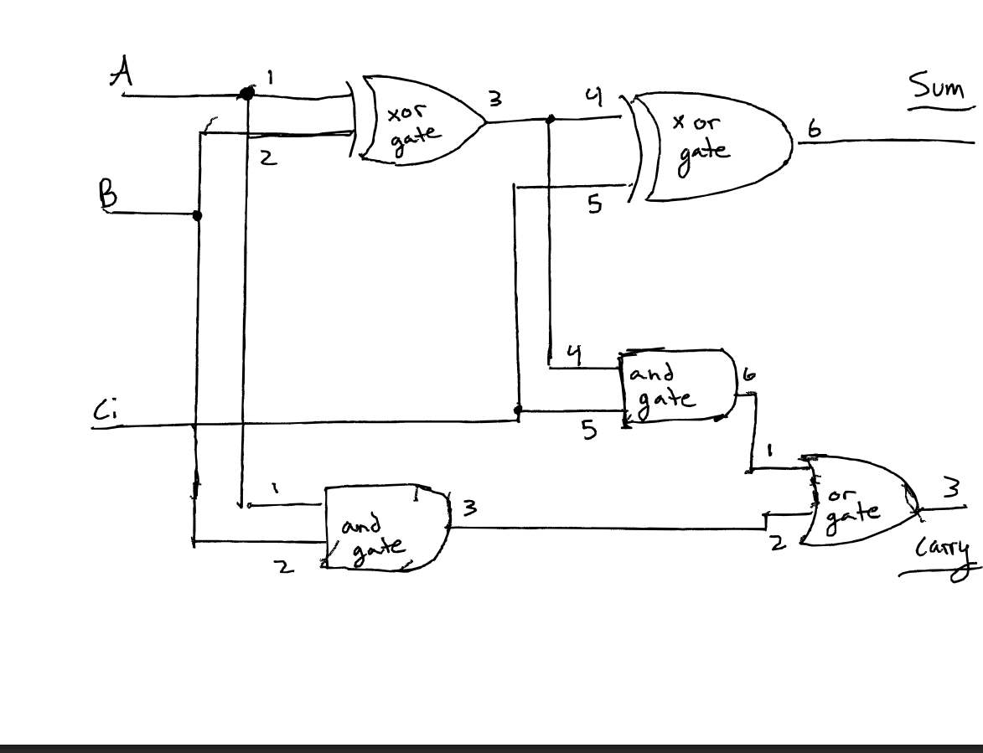
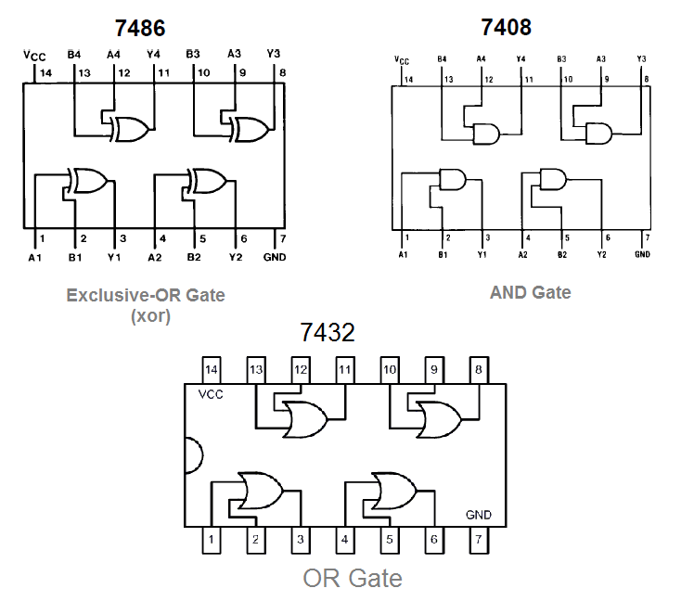
Diagram:
Notes:
Each small IC’s holds 4 specific gates. We will not be needing all of them. To Build to breadboard and have LEDs that turn on to show that if wiring and the Full Adder works, we will follow the diagram. In which I have put each pin that directly corresponds to each port.

Slide 4
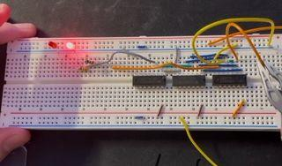
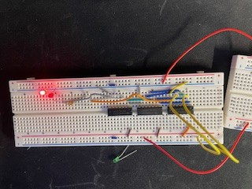
Translating onto a breadboard
Notes:
(XOr gates) 08’s are on the left, (And Gates) 86’s are in the middle , (OR Gates) 32’s are on the right.
You can change the wiring with connected to the Or gates to change which LED is on. With the wiring being grounded the closest bulb is on and with the wiring VCC ( Positive voltage) if changes the bulb to the farther one on the right. I also used 330 risistors to allow enough power through to light the bulb yet not brun it out immediately.

